Slide 1

Explain female trade protectionism
Xiao Sun
Dec. 5, 2022

Slide 2
Introduction
Question:
What drive female trade protectionist tendency?
Dataset:
1995-1998 third wave of the World Values Survey (WVS)
Model:
multinomial logit

Slide 3
Research Design: hypotheses
H1:
Women tend to oppose free trade when they are restricted by their family burden.
H2:
Women tend to oppose free trade when they feel their job security threatened by foreign immigrants.
Notes:
Causal, correlational

Slide 4
Research Design: construction of variables
DV
female trade preferences:
“support,” “limit,” and “other” (including “other answers” and “DK”)
IVs
family burden:
“V89 Marital status”, “V90 How many children”, “V13 Parents responsibilities to their children”, “V220 Employment status” (housewife)
job insecurity :
“V63 jobs for our nationality”, and “V134 immigration policy”
Control variables:
age, class, education, occupation, union membership, religion, and national pride
Notes:
Sample 78 thousand or so
Spent a lot of efforts on recategorization of variables. Data cleaning
DV as multi-categorical variable, three levels, base level, support
V134, immigration policy, choices:

Slide 5
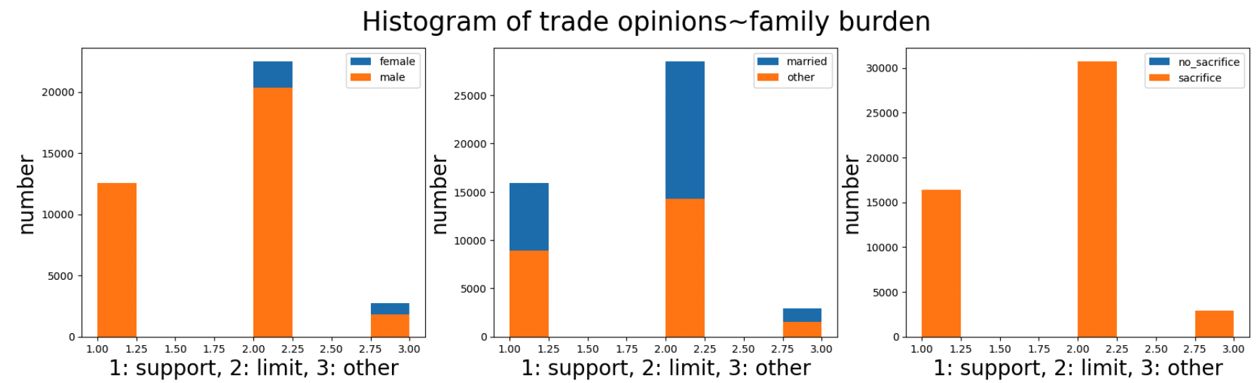
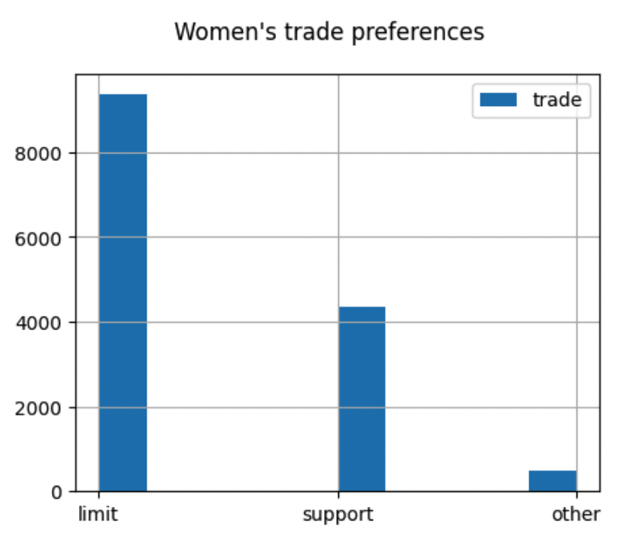
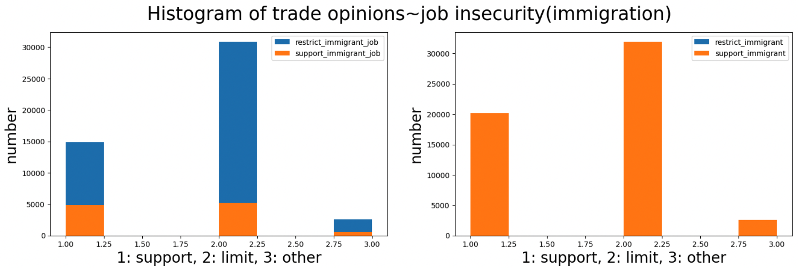
Research Design: construction of variables

Slide 6
Results
Main Ivs
Statistically significant:
Positive coefficients: parents’ responsibilities (0), housewife (0);
Negative: jobs for nationality (0) and immigration (0)
No significant:
Positive: marital status (0.945), number of kids (0.054)
Control variables:
except education (0.106) and occupation (0.18), other variables are statistically significant: age, class, union, party, religion, and national pride.
Notes:
Four indicators of family burden, only parents’ responsibilities (0), housewife (0) significant
Interpretation:
Compared to “support trade”,
women who are more valuing parents’ responsibilities to children (should sacrifice for their kids) are more likely to oppose free trade.
women who are housewife are more likely to oppose free trade.
women who think jobs are only for our nationality are more likely to oppose free trade.
women who think people should not come for jobs are more likely to oppose free trade.
Therefore, the results can partially confirm my first hypothesis and fully support my second hypothesis.

Slide 7
